Slide 1
MDA
CS 4730 – Computer Game Design

Slide 2
Topics
MDA Framework
Definition with examples
Two specific examples of viewing game under this lens:
Monopoly
Dark Souls 1

Slide 3
MDA Framework
Popularized in a short paper by Robin Hunicke, Marc LeBlanc, and Robert Zubek.
Aims to kick off a conversation about games that gets away from words like “fun” and “gameplay”
Instead replaces those words with three layers
Mechanics
Dynamics
Aesthetics

Slide 4
MDA Framework
Mechanics – The underlying rules of the game (code level rules).
Dynamics – The ways in which game rules combine to create specific experiences over time.
*When most people say “game mechanic” they really mean mechanic along with its dynamics
Aesthetics – The desirable emotional response a player has when they interact with the game

Slide 5
Mechanics
The underlying rules of the game (code level rules).
What are the mechanics of super Mario bros. 3?

Slide 6
Dynamics
The ways in which game rules combine to create specific experiences over time.
Mario Kart: What are the dynamics of item selection?

Slide 7
Aesthetics
The desirable emotional response a player has when they interact with the game
The paper lists 8 (non-exhaustive) aesthetics that game often have.
They are on the following slides (with examples)
*Note: Many games invoke multiple aesthetics

Slide 8
Aesthetics
Aesthetic 1 – Sensation: Game as sense pleasure

Slide 9
Aesthetics
Aesthetic 2 – Fantasy: playing make-believe

Slide 10
Aesthetics
Aesthetic 3 – Narrative: Game as drama

Slide 11
Aesthetics
Aesthetic 4 – Challenge: Game as obstacle course

Slide 12
Aesthetics
Aesthetic 5 – Fellowship: Game as social framework

Slide 13
Aesthetics
Aesthetic 6 – Discovery: Game as uncharted territory

Slide 14
Aesthetics
Aesthetic 7 – Expression: Game as self-discovery

Slide 15
Aesthetics
Aesthetic 8 – Submission: Game as past-time

Slide 16
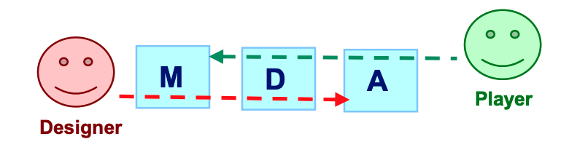
Designers vs. Players

Slide 17
Full Example: Monopoly

Slide 18
Monopoly: Mechanics
What are the mechanics of Monopoly?
Take turns.
Roll 2 dice: move to square
If not purchased, you can purchase
if owned, you pay rent for staying on that space
Can build hotels, etc. on spaces you own if you have entire color
other mechanics of monopoly?

Slide 19
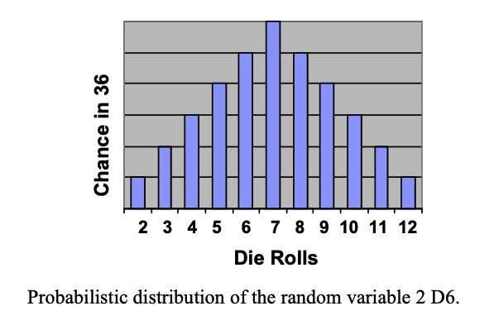
Monopoly: Dynamics
This is the interesting part…
Dynamic 1: Die Rolls

Slide 20
Monopoly: Dynamics

Slide 21
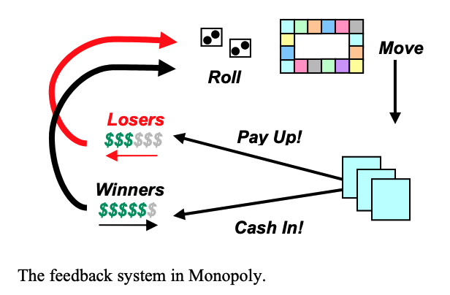
Monopoly: Dynamics
This is the interesting part…
Dynamic 2: Feedback loop

Slide 22
Monopoly: Aesthetics
What are the aesthetics of monopoly?
Challenge: Competitively trying to beat each other
But there is more to it than that. The aesthetics we listed don’t really capture the emotional response of monopoly
Winner-take-all
For losers: Hopelessness, frustration, etc.

Slide 23

Last Example: Dark Souls 1

Slide 24
Dark Souls: Mechanics
Dungeon Crawler
Bonfire is save point
Try to get to next bonfire, kill baddies along the way
If you die, go back to bonfire and try again
Money = souls. If you die, drop all your stuff at your death location
Try to get back there on next try to get stuff back
Spend souls to level up, upgrade weapons, etc.

Slide 25
Dark Souls: Dynamics
SO MANY, but here are some notable ones:
Bonfire restores health, “potions”, but revives all enemies.
Dynamic: Bonfire is safe space, but resets all challenges. You are forced to go through the baddies in one try at some point.
No warping, you must walk everywhere!
Dynamic: As you get further away from known safe areas, situation becomes much more risky and dangerous (Don’t want to lose all of your souls!)
Want safety, have to walk all the way out!!

Slide 26
Dark Souls: Dynamics
Holding shield up makes stamina recover more slowly. Swinging sword depletes stamina, getting hit on shield depletes it too.
Dynamic: Nice tradeoff between attack and defense. Attack too much and you are at risk of being punished. Defend too much and stamina won’t recover

Slide 27
Dark Souls: Aesthetics
From our list:
Challenge: Game is essentially a big obstacle course
Narrative: Woven with a story about a character on a hopeless quest to undo a curse in a hopeless, darkening world.
Fellowship: Online play allows others to entire your world and assist you with tough bosses.
Others, the mechanics and dynamics weave really well to create the feelings of:
Hopelessness: The game hardly tells you what to do. Undo a curse…go on and figure it out on your own, no one really knows how to do it.
Loneliness: As you descend further and further from the safety of a bonfire. Even the bonfires are a bit depressing.
Elation: When you overcome a challenge

Slide 28
Dark Souls: Aesthetics
Last thoughts on this game’s aesthetics:
This game is unapologetic about its desire for you to experience its difficulty and overcome its challenges yourself. Like its world and story, there is no help to be found and no tutorial to be found. You have to figure things out on your own and explore this world on your own…and when you finally overcome its challenges you are rewarded with the feeling that you did so yourself, by mastering the game. This game is EXTREMELY punishing. You will not beat it by finding some cheesy strategy. You have to get good at it. In this way, the game reminds me of a parent showing tough love. It wants you to succeed, but won’t do the work for you.

